Slide 1
Building your first C# program
Hello World

Slide 2
File | New | Project Visual C#: Console Application Name: HelloWorld Solution name: Week1

Slide 3
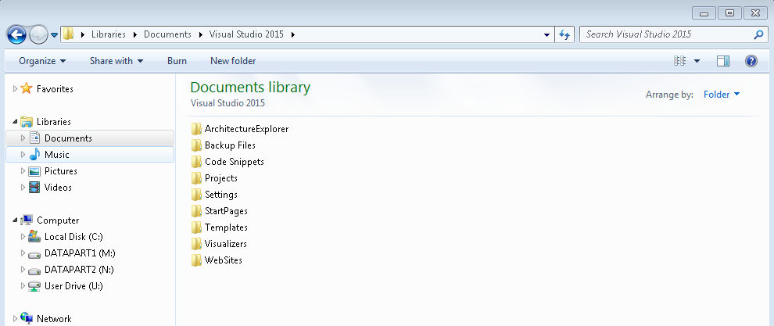
Let’s find your file in Windows Explorer
C:\Users\<login name>\Documents\Visual Studio 2015

Slide 4
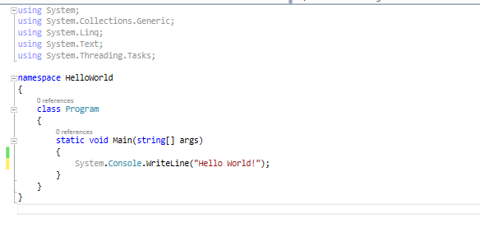
System.Console.WriteLine(“Hello World!”);

Slide 5
Compiling and running your C# Program
Cannot comply, building in progress….

Slide 6
BUILD
Runs the C# compiler, converting the Source Code to intermediate language, and creates an executable file called an assembly. (.exe or .dll)
Build Solution (or Project)
Correct any compiler errors

Slide 7

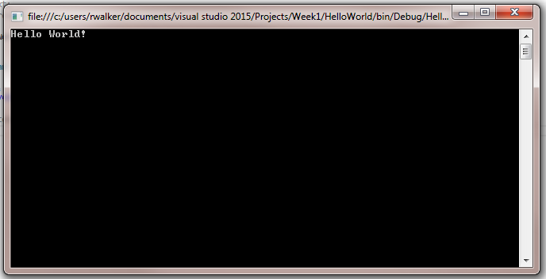
Click Start

Slide 8
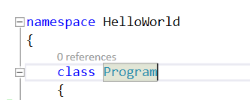
Namespace and Class
Namespace
A scope of related objects.
Everything in C# must reside within a class
The basic construct of the type system.

Slide 9

Main – like Highlander, there can only be one
Main is the main entry point of a console application or Windows application.

